Slide 1
Comprehensive Survey Project
(in-depth analysis of research literature) 1. Scalable SPARQL Querying of Large RDF Graphs (aug-sep 2011) 2. Towards Effective Partition Management for Large Graphs (may 2012)
Vineet Choudhury
academic exercise for course CS561: Web Data Management

Slide 2
Quick Background
Characteristics of cluster machines solutions used so far
-- Hash partition triples across multiple machines
-- Have to ship data around the network for complex SPARQL machines
Several attempts made to use MapReduce for SPARQL querying but these techniques are unable to leverage graph partitioning and have storage layers that are not optimized for RDF data.

Slide 3
Paper 1
Scalable SPARQL Querying of Large RDF Graphs
Jiewen Huang Daniel J. Abadi Kun Ren

Slide 4
Clustered RDF DB Systems Gaining Importance
Explosive growth of RDF data
Single node RDF management systems are abundant
(Sesame, Jena, RDF-3X, 3store etc)
As amount of RDF data continues to scale, it is no longer feasible to store entire data sets on a single machine and still be able to access the data at reasonable performance
Thus the requirement for clustered RDF database systems is becoming increasingly important

Slide 5
Clustered RDF DB systems: Not Explored Significantly
Unfortunately far fewer research progress made towards clustered RDF database systems
Existing solutions such as SHARD, YARS2, Virtuoso generally hash partition triples across multiple machines and parallelize access to these machines as much as possible at query time
Work well for simple index lookup queries but efficiency is far from optimal for more involved queries such as RDF benchmark queries
These systems have to ship data around network at query time in order to match complex SPARQL patterns and thus can become performance bottleneck due to high communication requirement
Also these systems use storage layers that were not originally designed for RDF data
Focus of study

Slide 6
Primary Contributions of this work
A horizontally scalable RDF database system.
Data partitioning and placement techniques.
N-hop guarantee.
Can determine if a query is parallelizable without communication ahead of processing.
An algorithm to decompose queries into parallelizable chunks.
Minimize the number of joins on immediate results.
Assumptions:
Data is read-only after being loaded.

Slide 7
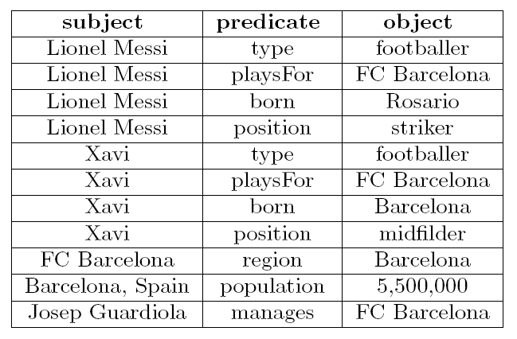
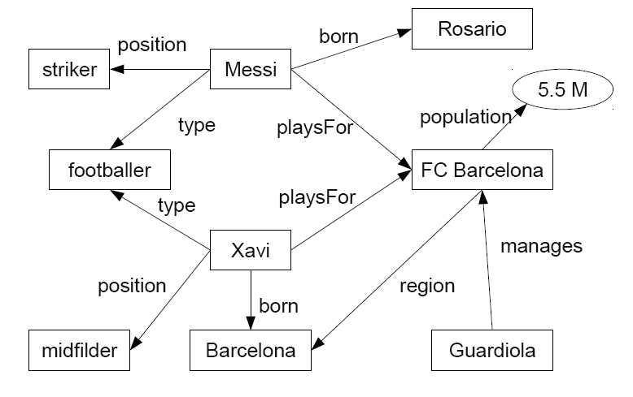
RDF as Triples and a Graph
Many RDF stores (systems that are built to store and query RDF data) store the triples in a relational database, using a single relational table containing three columns

Slide 8
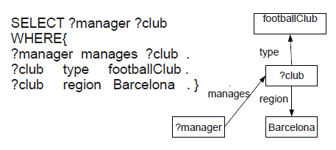
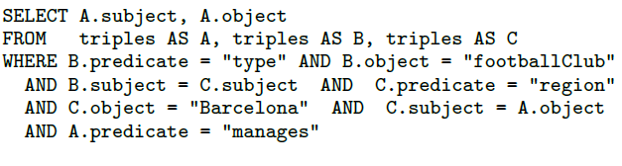
The SPARQL Query Language
A set of basic graph patterns.
A pattern is a RDF triple that contains variables.
Answering SPARQL can be seen as finding subgraphs in the RDF data that match the graph pattern
S-O join
S-S join
Notes:
S-S and S-O joins are the most common.

Slide 9
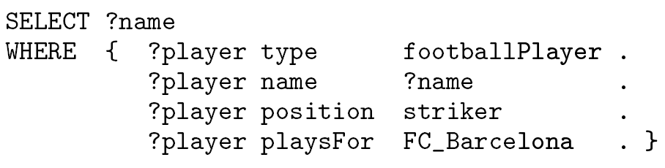
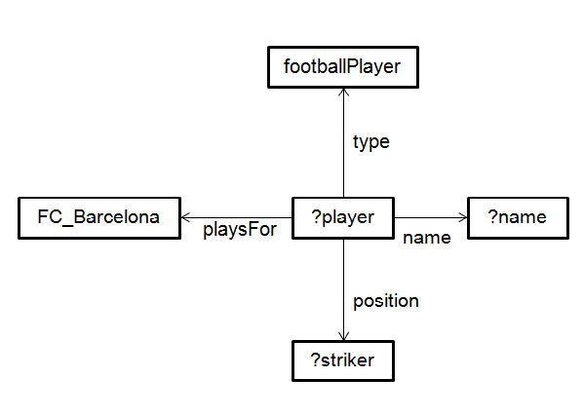
Example for Star Pattern
Notes:
Star pattern with a single center vertex (that is usually a variable) and one or more edges emanating from this center vertex to variable or constant vertexes.

Slide 10
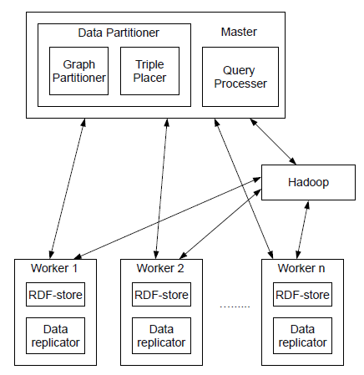
System Architecture
Fed RDF data into data partitioner module which performs a disjoint partitioning of the RDF graph by vertex
O/P graph is used to assign triples to worker machines according to triple placement algorithm
Data replicator determines which triples are on the boundary of its partition and replicates these triples according to n-hop guarantee
Query processor accepts queries and determines whether the SPARQL pattern can be searched for completely in parallel or not. If not, it decomposes the SPARQL query
Use Hadoop to manage all parts of query processing that require multiple machines to work together

Slide 11
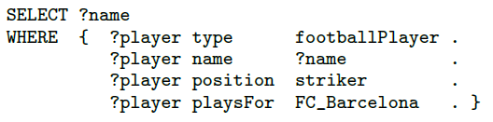
Data Partitioning: A Case Study
Star queries
Common but not always.
Hash partitioning work wells in this case.
Patterns that share neither a common subject, predicate, nor object.
Heavy communication cost with hash partitioning.
Graph partitioning (Edge vs. vertex partitioning).
Notes:
When data is partitioned across multiple machines, the particular partitioning algorithm can make a large difference in the amount of data that needs to be shipped over the network at query time.

Slide 12
Data Partitioning: Edge vs. Vertex Partitioning
Every RDF triple describes a particular edge in the RDF graph (i.e the number of RDF triples in a data set is equal to the number of edges in a RDF graph)
The most obvious way to perform graph partitioning is via ‘edge partitioning’ a RDF graph into disjoint subsets
Unfortunately, such an approach complicates the execution of star queries since vertexes on the boundary of a partition might have some edges on one machine and some edges on another machine, thereby causing additional network communication at query time relative to simple hash partitioning
Since star queries are quite common, vertex partitioning is used, such that each machine receives a disjoint subset of RDF vertexes that are close to each other in the graph

Slide 13
Data Partitioning: Vertex Partitioning
Remove triples with rdf:type predicates (and other similar predicates with meaning “type”).
If these “type” triples are included, every entity of the same type would be within two hops of each other
These connections make the graph more complex and reduce the quality of graph partitioning significantly, since the more connected the graph is, the harder it is to partition it
METIS partitioner.
Input the RDF graph as a undirected one.
Expect a more scalable partitioner in the future.
Notes:
In fact, we find that removing the bias to place objects of the same type on the same machine can sometimes improve query performance, since this causes entities of popular types to be spread out across the cluster, which allows queries involving in these types to be executes in parallel in an equitable fashion.
Vertex partitioning of graphs is a well-studied problem in computer science, and we therefore can leverage previously existing code to do the partitioning for us. In our current prototype we use the METIS partitioner. We input the RDF graph as an undirected graph to METIS, specify the desired number of partitions (which is usually the number of machines in the cluster) and the METIS outputs partitions of vertexes that are pairwise disjoint.

Slide 14
Triple Placement
Place each triple in the partition that owns the vertex corresponding to the subject.
Allow data overlap to minimize network communication
-- trade off between storage overhead and communication overhead
N-hop guarantee
-- The extent of data overlap
-- If a vertex is assigned to a machine, any vertex that is within n hop of this vertex is also stored in this machine
Notes:
Since we are using Hadoop as the query execution layer in our system to do the coordination of query processing across machines, there can be a dramatic performance difference between queries that can be processed completely in parallel without any coordination (where the use of Hadoop can be circumvented) and queries that require even a small amount of coordination (where Hadoop needs to be red up). This is because Hadoop usually has at least 20 seconds of start-up overhead, so query time can increase from a small number of seconds (or even less) for completely parallelizable queries, to at least 20 seconds for queries that require data exchange.

Slide 15
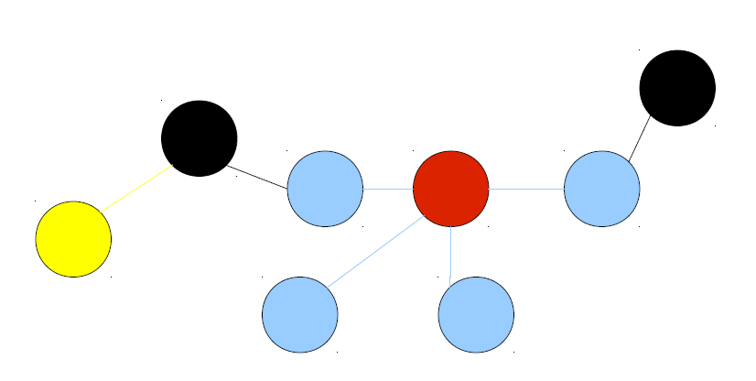
Example for N-hop guarantee

Slide 16
More on N-Hop Guarantee
Directed n-hop guarantee
-- Triples (s,p,o) and (o,p,o’) where the subject of one triple is equal to object of another triple are not guaranteed to end up in same partition if only one hop is guaranteed (however they will end up in the partition that owns vertex s under a 2-hop guarantee)
-- Triples (s,p,o) and (s’,p’,o) are not guaranteed to end up in the same partition (even though they are connected via same object) no matter how large the n-hop guarantee is
Undirected n-hop guarantee
-- Since it is not unusual for a SPARQL query to include such an “object-connected” graph pattern, in many cases it is preferable to use an undirected n-hop guarantee
Add a triple (v, <isOwned>, ‘Yes’) for each base vertex v in the vertex partition

Slide 17
Query Processing
Query execution is more efficient in RDFstores than in Hadoop
-- Push as much of the processing as possible into RDFstores
-- Minimize the number of Hadoop jobs
-- The larger the hop guarantee, the more work is done in RDFstores

Slide 18
Two Important Terms
PWOC Query
-- If a query can be answered entirely in RDF-stores without data shuffling in Hadoop, it is called a “PWOC query” (parallelizable without communication)
DoFE (distance of farthest edge)
-- The concept of DoFE is a measure of centrality in a graph. Intuitively, the vertex in a graph with the smallest DoFE will be the most central in a graph

Slide 19
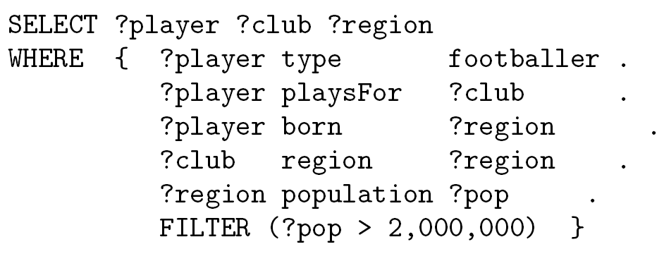
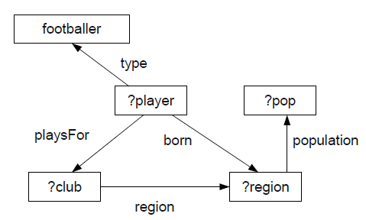
Understanding DoFE
3
∞
2
3
∞
2
∞
∞
2
2

Slide 20
Is a Query PWOC?
Given a query and n hop guarantee, is the query PWOC
-- Choose the “center” of the query graph
-- Calculate the distance from the “center” to the furthest edge
-- If distance > n, communication is needed; not needed otherwise

Slide 21
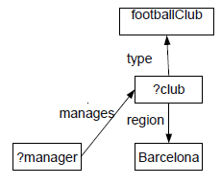
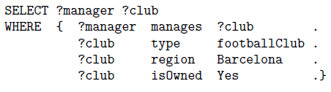
Query Processing: Example
Data partitioning uses an undirected 1-hop guarantee
The above query will be considered a PWOC query because the DoFE for club is the same as the hop guarantee
A triple pattern (?club, ‘<isOwned>’, “Yes’) will be added to the query which is then issued to the RDF stores

Slide 22
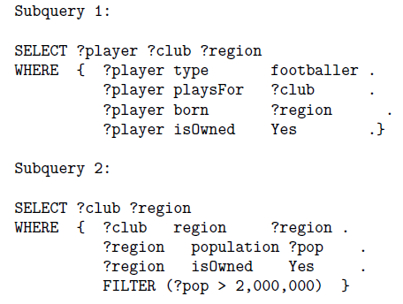
Query Processing: More Example
Data partitioning uses an undirected 1-hop guarantee
The above query is not PWOC and is therefore decomposed into PWOC queries
Player and region are chosen as cores in subqueries because they both have DoFE 1
After the two subqueries are executed in the RDF-stores, the intermediate results are joined on club and region by a Hadoop job

Slide 23
Experiments
20-machine cluster
Undirected 1-hop and 2-hop guarantees
On the same rack, connected via 1Gbps network
RDF-3X 0.3.5
Hadoop 0.19.1 on Java 1.6.0
Competitors
RDF-3X on a single machine
SHARD, another horizontally scalable RDF-store
A simple hash partitioning version of our system
Graph partitioning (the proposed system)

Slide 24
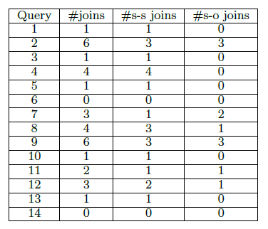
Experiments: Benchmark
The Lehigh University Benchmark (LUBM)
RDF data scalable to an arbitrary size;
14 extensional queries;
50GB, 270 million triples.

Slide 25
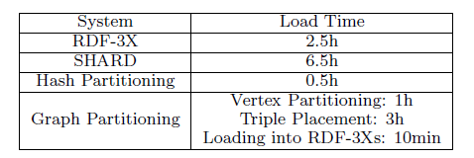
Experiments: Data Load Time
Notes:
SHARD’s high load time is due to format conversion

Slide 26
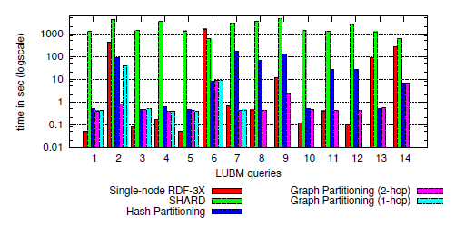
Experiments: Performance
Fast Queries: 1 3 4 5 7 8 10 11 and 12
Slow Queries: 2 6 9 13 and 14.
One S-O join: 8 11 and 12 (up to 90 seconds)
More S-O joins: 2 7 and 9 (up to 170 seconds)
Notes:
Queries 1,3,4,5,7,8,10,11 and 12 run for less than 1 second on single machine RDF-3X, so we call them fast queries.
Queries 2,6,9,13 and 14 run for more than 10 seconds on single machine RDF-3X, so we call them slow queries

Slide 27
Experiments: Results
Fast queries perform slightly better on a single machine
Slow queries show dramatic improvement when run on multiple machines. The improvement ranges from 5 times (query9) to 500 times (query2) faster
Hash partitioning
-- Queries 8, 11 and 12 have only one subject-object join and take up to 90 seconds
-- Queries 2,7 and 9 have two or three subject-object joins and take up to 170 seconds

Slide 28
Conclusion and Future Work
A scalable RDF database systems that outperforms alternative solutions
Based on graph partitioning.
N-hop guarantee.
Future Work
Make the system dynamic and fault-tolerable.
Distributed graph partitioner.

Slide 29
Paper 2
Towards Effective Partition Management for Large Graphs
Shengqi Yang Xifeng Yan Bo Zong Arjit Khan

Slide 30
Key Points
Neccessity of efficient graph data management systems
Two-level partition architecture: primary and secondary partitions
Two partitioning techniques: complementary partitioning and on-demand partitioning
Notes:
Neccessity of efficient graph data processing as existing solutions (i.e static partition scheme) does not work well with queries have strong locality and skewed workload

Slide 31
Motivation
Increasing requirements for efficient graph data processing
-- Interesting graphs are huge with millions, even billions of vertices, making common graph operations computationally intensive (e.g. Information network, social network, biological networks etc )
-- Explosive growth in RDF data requires efficient management
(e.g. the recent linked data project has published more than 20 billion RDF triples)

Slide 32
Existed Solutions
Memory-resident solution (e.g. HPC)
-- Running on single server
-- Difficult/Impossible to accommodate the content of an extremely large graph
Simple distributed solution (e.g. Hadoop)
-- Running on commodity cluster
-- poor locality and little work per vertex
Simple distributed solution (e.g. Pregel)
-- unbalanced workload and intensive inter-machine communication

Slide 33
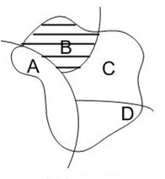
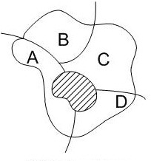
Pregel Limitations
unbalanced workload
inter-machine communication

Slide 34
Focus of Study
Graphs arising from social networks and RDF
-- well defined partitions often do not exist
-- previous work has focused on graphs arising from scientific applications where well defined partitions often exist
Focus is not to develop new graph partition algorithms, but to adjust partitions to serve queries efficiently

Slide 35
Solution Introduced: SEDGE
SEDGE: Self Evolving Distributed Graph Management Environment
-- Sedge is a software framework that supports large scale graph processing and is essentially inspired by Google’s Pregel
-- Solve limitations of Pregel
+workload balancing by replication
+minimize inter-machine communication by adding important
functions to support overlapping partitions
-- two level graph partition architecture
+complementary graph partitioning
+on-demand graph partitioning (partition replication & dynamic
partitioning)

Slide 36
Outline
Architecture
Techniques
Experiments

Slide 37
Architecture

Slide 38
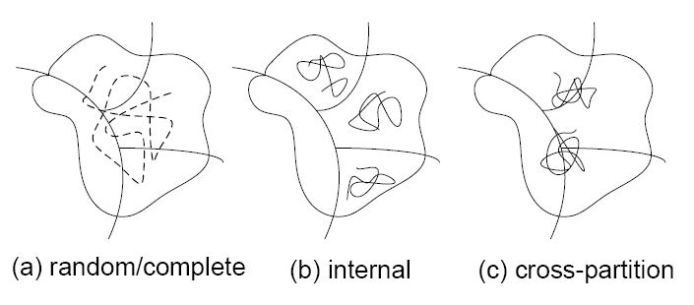
Graph Query Access Patterns
(a) Random query: the query randomly access the vertices of the entire graph.
(b)Internal query: the query only accesses the vertices within a particular partition. Intensive internal query on a specific partition may lead to unbalanced workload.
(c)Cross-partition query: the query has to access the vertices in different partitions. Cross-partition query may lead to intensive inter-machine communication
Notes:
For random query, a static balanced partition scheme might be the best solution
For internal query, a static balanced partition scheme might work but intensive internal query on a specific partition might lead to unbalanced workload
For cross partition query, the static partition scheme might fail due to inter machine communications

Slide 39
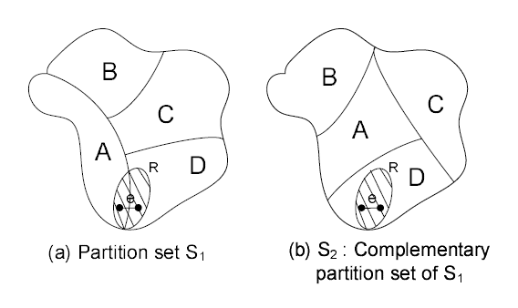
Complementary Partitioning
In the new partition set, e, will be served within the same partition. Therefore, the new partition set can handle graph queries that have trouble in the original partition set.
If there is room to hold both S1and S2 in clusters, for a query Q visiting the shaded area R in S1, the system shall route it to S2 to eliminate communication cost. Meanwhile, the new partition set can also share the workload with original partition set.
This complementary partitioning idea can be applied multiple times to generate a series of partition sets. We call each partition set a “primary partition set”
Complementary Partitioning is to repartition a graph such that the original cross-partition edges become internal ones

Slide 40
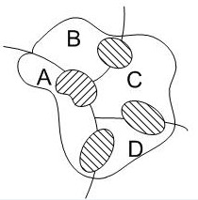
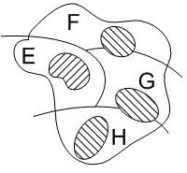
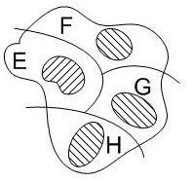
An Iterative Solution
…
…
Iteratively repartition the graph
Pros
Effective communication reduction
Cons
Space limitation

Slide 41
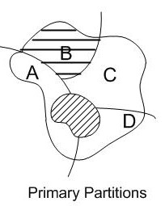
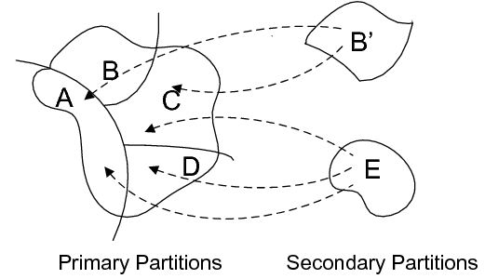
Two-Level Partition Architecture
Create a replicated partition or generate a new overlapping partition in an idle machine so that the workload can be shared appropriately.
This strategy called On-demand Partitioning, will generate new partitions online.
These add-on partitions, called “secondary partitions”, could last until their corresponding workload diminishes.

Slide 42
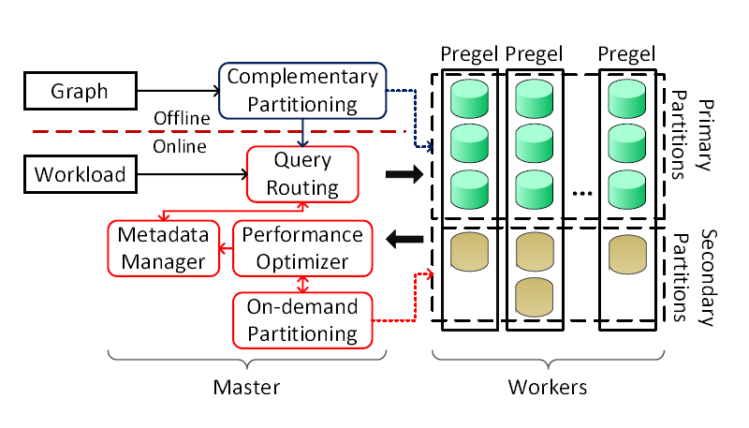
SEDGE System Architecture
Notes:
SEDGE is designed to eliminate inter-machine communication as much as possible
The offline part first partitions the input graph in a distributed manner and distributes them to multiple workers. It creates multiple partition sets so that each set runs independently
The online part collects statistical information from workers and actively generates and removes partitions to accommodate the changing workload

Slide 43
Technique:
Complimentary Graph Partitioning

Slide 44
Technique: Complimentary Graph Partitioning
Complementary partitioning is to find multiple partition sets such that their partition boundaries do not overlap
Formal Problem Definition: Given a partition set {P1, P2, ..., Pk} on G and the cut edges Ec = {e1, e2, ..., ei}. The problem is to partition G into a new partition set {P1, P2 , ..., Pk } satisfying the same partitioning criteria (e.g., minimum cut) such that the new cut edges do not overlap with Ec.

Slide 45
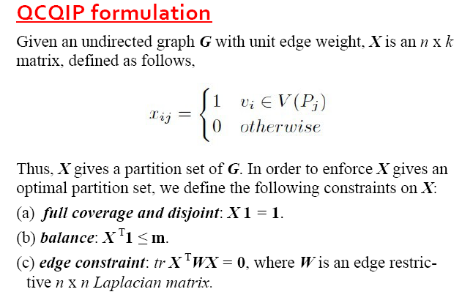
Complimentary Graph Partitioning (contd.)

Slide 46
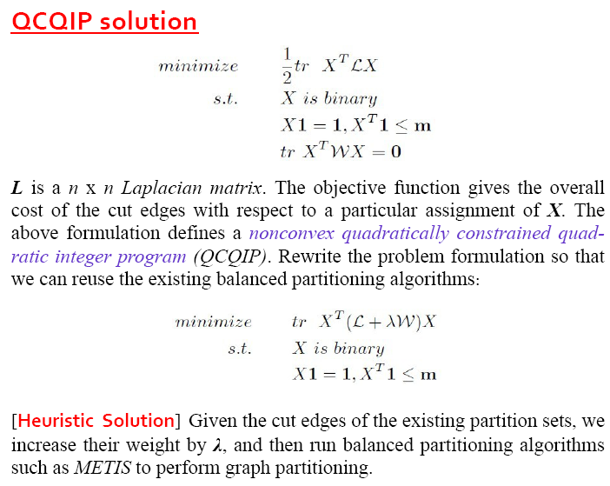
Complimentary Graph Partitioning (contd.)

Slide 47
Complimentary Graph Partitioning (contd.)
The heuristic algorithm can be applied multiple times to generate a series of complementary partition sets, each of which try to partition the graph such that the boundary edges in one partition set will be internal edges in another partition set
With multiple partition sets, for each vertex u, there could be several partitions P1, P2, . . . , Pl to handle queries submitted to u. Queries should be routed to a partition where u is far away from partition boundaries. We define such a partition as a safe partition for vertex u.

Slide 48
Technique:
On-Demand Graph Partitioning

Slide 49
Understanding Query Hotspots
In the processing of many graph queries, primary partitions could have hotspots that are frequently visited. The queries heading to these partitions will suffer longer response time
There are two kinds of query hotspots: (1) internal hotspots that are located in one partition; (2) cross-partition hotspots that are on the boundary of multiple partitions
Partition replication and Dynamic partitioning - Two partitioning techniques developed to generate secondary partitions on demand to handle hotspots

Slide 50
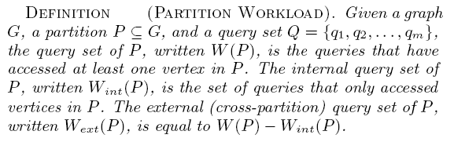
Partition Replication to Handle Internal Hotspots
Given a partition P, when its internal workload (Wint(P)) becomes intensive, it will saturate the CPU cycles of the machine that holds P. One natural solution is to replicate P to P’. If there is an idle machine with free memory space, Sedge will send P to that machine. Otherwise, it will find a slack partition and replace it with P. A slack partition is a secondary partition with low query workload on it. By
routing queries to P’, the workload on P could be reduced.

Slide 51


Cross-Partition Hotspot Analysis
Two important ratio
where Eext(P) is the number of cross partition edges between P and other partitions,
and Eint(P) is the number of internal edges
If r is significantly higher than p, it could be reasonably assumed that there are cross-partition hotspots in P
Notes:
When cross-partition hotspots exist, primary partitions have to communicate with each other frequently to answer cross-partition queries. Instead of replicating multiple partitions, it is better to generate new partitions that only cover cross-partition hotspots. The new partitions will not only share heavy workload, but also reduce communication overhead, thus improving query response time.

Slide 52
Track Cross Partition Queries
Besides detecting cross-partition hotspots, we need a method to track the trail of cross-partition queries and pack them to form a new partition
It is intuitive to record each query in the form of its exact search path. However, it is not only space and time consuming for profiling, but also difficult to generalize
Instead we mark the search path of a cross partition query with coarse-granularity units, color-blocks
A color-block is a set of vertices Vi ⊂ V where they are assigned with a unique color ci. For any vertex v ∈ V , it has one and only one color. Using color-blocks, we are able to coarsen a graph with a much smaller number of units

Slide 53
Understanding Color Blocks
P1
P2
v2
v1
v3
v5
v4
C3
C1
C2
Blocks: coarse-granularity units that trace the path of cross-partition queries. e.g., C1,C2 and C3.
Advantages:
Query generalization.
Profile a query with fewer features

Slide 54
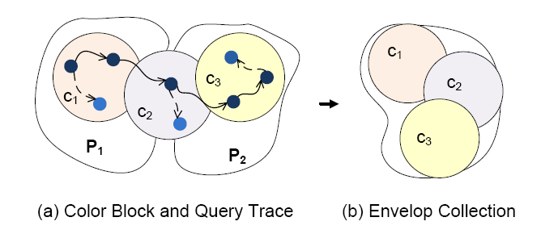
Dynamic Partitioning – Query Profiling
Envelope: a sequence of blocks that covers a cross partition query. Note that by tracking cross-partition queries using color-blocks, each query can be profiled as an envelope
Envelope Collection: put the maximized number of envelopes into new partition wrt. space constraint.

Slide 55
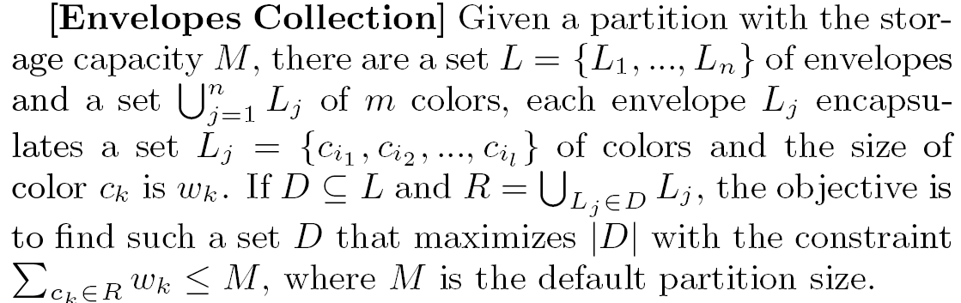

Dynamic Partitioning – Envelopes Collection
A greedy algorithm is proposed based on the intuition that combining similar envelopes consumes less space than combining non-similar ones.
Given two envelopes the overlap of their color block sets is measured as Jaccard coefficient
Performing pair wise similarity given n envelopes is O(n2)
We use a hash based algorithm called Locality Sensitive Hashing (LSH) and adopt a LSH scheme called Min-Hash

Slide 56
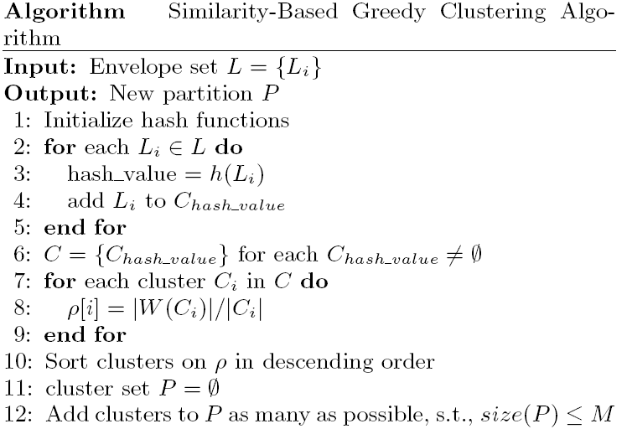

Similarity Based Greedy Algorithm
Cluster the envelopes in the same bucket produced by Min-Hash
Each cluster is assigned with a benefit score where W(C) is the number of cross partition queries denoted by all the envelopes in the cluster C and C is the size of the cluster
Combine the clusters with highest benefit

Slide 57
Understanding Similarity-Based Greedy Algorithm
The algorithm intends to combine similar envelopes sharing many common color-blocks.
2-step greedy algorithm:
1) Similarity search (nearest neighbor search).
Locality Sensitive Hashing (LSH): Min-Hash, in O(n)
2) Envelope combining
Cluster the envelopes in the same bucket produced by Min-Hash.
Combine the clusters with highest benefit.
Notes:
We use Min-Hash as a probabilistic clustering method that assigns a pair of envelopes to the same bucket with a probability proportional to the similarity between them.
It is straightforward to consider these buckets as clusters and combine the envelopes within the same buckets together.

Slide 58
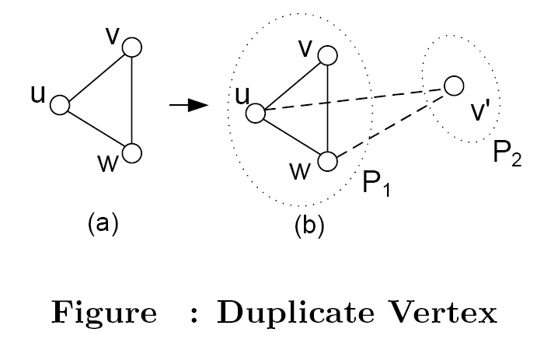
Duplicate Sensitive Graph Query
Duplicate Insensitive Graph Queries are queries that can be correctly answered on overlapping partitions
How Sedge handles duplicate sensitive graph queries?
--If a duplicate sensitive graph query running on a secondary partition exceeds the boundary of the partition, the query will be terminated and restarted in a primary partition

Slide 59
Technique: Runtime Optimization

Slide 60
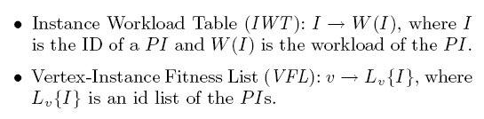
Query Routing
The master node maintains following data structure to coordinate query routing
A query shall be routed to a Pregel instance where the initiated vertex is in the safe region
Given a vertex v, the PIs where v is in safe region are ranked higher in VFL
Given a query, the algorithm routes the query to the first PI in its VFL that is not busy with respect to the IWT

Slide 61
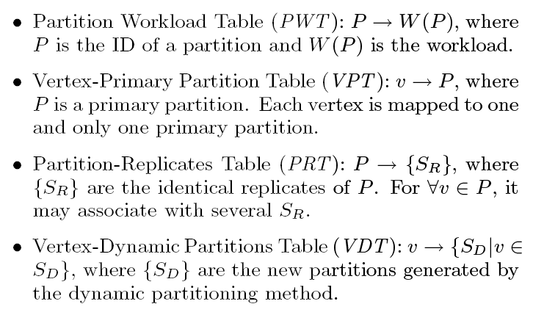
Query Routing (contd.)
Vertex Partition Mapping: In order to process queries, each Pregel instance needs to maintain the following tables to map vertices to partitions. All partitions are mapped onto unique IDs.

Slide 62
Partition Workload Monitoring
The workload monitoring component is built in the optimizer module.
Report messages from all Pregel instances are sent to the master at the end of each period
Typically a report message from a Pregel instance I includes the number of the queries served in I (i.e., Wint(I) and Wext(I)), the total access times of the vertices (q∈W(I) |V (q)|), and the CPU run time of the machines holding I. These messages encode the workload information of Pregel instances. The master updates the IWT accordingly
Analogously, each Pregel instance collects runtime information of their partitions and calculates the ratio between the total access times of the vertices and the size of the partition and sorts the partitions based on the ratio. Then with respect to the threshold ratio, a partition can be marked as a hot or a slack one. The information is maintained in the PWT

Slide 63
Partition Replacement
Secondary partitions are generated to deal with query hotspots. In practice, the space that can be used to accommodate additional partitions is often limited. Therefore, it is unlikely to create as many secondary partitions as possible. At the same time, in real world applications, query hotspots may become “slack” ones after a period. This practical issue motivates a partition replacement scheme that replaces a slack secondary partition with a newly generated one. In Sedge, when a replacement is needed, we simply select the slackest secondary partition and replace it with the one newly generated.

Slide 64
Dynamic Update & Synchronization
Sedge can adapt to dynamic changes in real world graph.
Since information of a vertex can be obtained by referring to the vertex-partition map, edge insertion and deletion can be accomplished directly.
For the insertion/deletion of edge (u,v) find the primary and secondary partitions of u and v, insert or delete the edge.
To delete vertex v, retrieve all of its edges and delete them, and then retrieve all of partitions containing v and delete v.
When insertion of vertices and following edge insertions make primary partition too big, we need to redo the partitioning from scratch.
when a query changes vertex values during its execution, the cost of keeping the vertex values in sync is usually quite high especially when there are many duplicates. In Sedge, we adopt a simple strategy: when a query changes a vertex value, a new update query is issued to all the corresponding partitions

Slide 65
Experimental Evaluation

Slide 66
System Evaluation: RDF benchmarks
SP²Bench
Employ the DBLP library as its simulation basis.
100M edges graph (11.24GB).
Query templates (5 of 12): Q2, Q4, Q6, Q7, Q8.
E.g. Q4: Given a journal, select all distinct pairs of article author names for authors that have published in the journal.
Cluster environment
31 computing nodes.
Among these nodes, one serves as the master and the rest as workers.

Slide 67
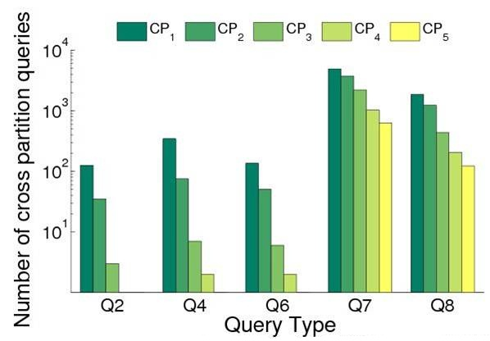
Effect of Complimentary Partitioning
Experiment setting
Partition configuration: CP1~CP5
Workload: 10⁴ Random queries
Result
Significant cross query reduction
Cross query vanishes for Q2,Q4 and Q6
We compare the performance by varying
the number of the used primary partition sets.

Slide 68
System Evaluation: real graphs
Datasets
Web graph: 30M vertices, 956M edges.
Twitter: 40.1M users, 1.4B edges.
Bio graph: 50M vertices, 68M edges.
Synthetic graph: 0.2B vertices, 1 Billion edges.
Query workload (three classic local graph queries)
h-hop neighbor search (h-NS).
h-step random walk (h-RW).
h-step random walk with restart (h-RWR).

Slide 69
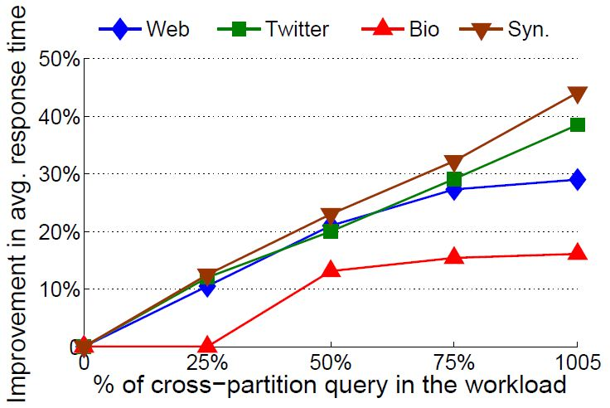
Scalability Cross-partition queries vs. Avg. response time
Experiment setting
Partition configuration: CP1+DP.
Workload: 10⁵ random queries with 0%, 25%, 75% and 100% cross queries.
Result
Effective for cross query
Effective for partitioning difficult graphs, i.e., Twitter and Bio graphs
We test the capability of Sedge to handle intensive cross-partition queries.

Slide 70
Comparison Between the Works of Two Papers

Slide 71
Comparison
PAPER 1 | PAPER 2
Both tries to minimize inter –machine communication but uses different techniques
Focuses on data partitioning techniques | Focuses on managing partitions to fit workload changes
Cannot handle updates | Can handle dynamic update and synchronization

Slide 72


Slide 73
Thank You!

